Slide 1
KEYLOGGERS AND SECURITY
Presented By:
D Ashvitha – Madha Engineering College – B.Tech.IT

Slide 2
OUTLINE
Problem Statement
Proposed System/Solution
System Development Approach
Algorithm & Deployment
Result
Conclusion
Future Scope
References

Slide 3
Problem Statement
Current Scenario: Keyloggers are increasingly used to monitor and track user activity, posing a significant security threat. It is crucial to predict and prevent unauthorized access and data breaches by understanding user behavior and identifying potential security risks.
Prediction Challenge: Anticipating user activity patterns and identifying anomalous behavior is essential for preemptive security measures, making accurate prediction of user activity a critical concern.

Slide 4
Proposed Solution
Keylogger Concept:
A keylogger is a type of software or hardware device designed to silently record keystrokes made by a user on a computer or mobile device. Its primary role is to discreetly monitor computer activities, capturing text typed by the user without the user's knowledge.
Functionality Overview:
Recording Keystrokes: Keyloggers operate by intercepting and logging keystrokes as they are entered on the keyboard. This means that every key pressed, whether it's a letter, number, or special character, is recorded by the keylogger.
Tracking Application Usage: In addition to logging keystrokes, keyloggers can also track the applications and programs being used by the user. This information provides insights into the user's activities, such as web browsing history, messaging applications, and document editing.
Ethical Considerations:
While keyloggers can serve legitimate purposes, such as parental control or employee monitoring in a professional setting, their use raises significant ethical considerations:
User Consent: It is imperative to obtain explicit consent from individuals before deploying keyloggers on their devices. Users have a right to privacy, and covertly monitoring their activities without their knowledge or consent is unethical and potentially illegal.
Purpose Limitation: Keyloggers should only be used for legitimate and lawful purposes, such as ensuring compliance with organizational policies or safeguarding minors from online threats.

Slide 5
System Approach
Introduction to Python:
Python is a versatile and powerful programming language widely used for various purposes, including web development, data analysis, artificial intelligence, and cybersecurity. Its simplicity, readability, and extensive library support make it an ideal choice for developing a keylogger.
Key Libraries:
tkinter (GUI): Python's tkinter library is commonly used for creating graphical user interfaces (GUIs). While not essential for a keylogger's functionality, tkinter can be utilized to create a user-friendly interface for configuring settings or viewing logs.
pynput (Keyboard Monitoring): The pynput library provides functionalities for monitoring and controlling input devices, such as keyboards and mice. It allows developers to capture keystrokes, track mouse movements, and perform other input-related tasks essential for building a keylogger.
json (Data Serialization): Python's built-in json library is used for serializing and deserializing data in JSON format. In the context of a keylogger, JSON serialization can be employed to structure and store captured data in a human-readable format, facilitating analysis and retrieval.
A keylogger operates discreetly in the background, capturing data without detection by the user. Here's how it accomplishes stealth operation:
Silent Execution: The keylogger program runs silently in the background without displaying any visible windows or notifications that could alert the user to its presence. This ensures that the user remains unaware of its operation.
Low Resource Consumption: To avoid raising suspicion, the keylogger minimizes its resource consumption, such as CPU and memory usage. By operating efficiently and unobtrusively, it reduces the likelihood of being detected through performance anomalies.

Slide 6
Algorithm & Deployment
Keylogger Algorithm:
Capturing Keystrokes: The keylogger algorithm continuously monitors the keyboard input using the pynput library. Whenever a key is pressed, the algorithm captures the keystroke event, records the corresponding key, and appends it to a log file or data structure for storage.
Monitoring Application Usage: To track application usage, the algorithm periodically queries the operating system for active processes or window titles. It identifies the currently focused application or window and logs this information along with the timestamp, providing insights into the user's activities.
Deployment Process:
Compatibility Checking: Before deployment, the keylogger undergoes compatibility testing to ensure it can run on the target machine's operating system and hardware configuration. This may involve testing on various platforms and environments to identify and address compatibility issues.
Stealth Deployment: The keylogger is deployed discreetly to avoid detection by the user. This may involve packaging the keylogger as a benign-looking application or script, utilizing techniques to hide its presence from system monitoring tools, and configuring it to start automatically upon system bootup.
Security Measures:
Access Control: The keylogger implements access controls to restrict unauthorized access to its configuration settings and recorded data. This may involve password protection, encryption of sensitive information, and user authentication mechanisms to ensure only authorized users can interact with the keylogger.
Data Encryption: To protect recorded data from unauthorized access or interception, the keylogger employs encryption techniques. they remain unintelligible without the appropriate decryption key

Slide 7
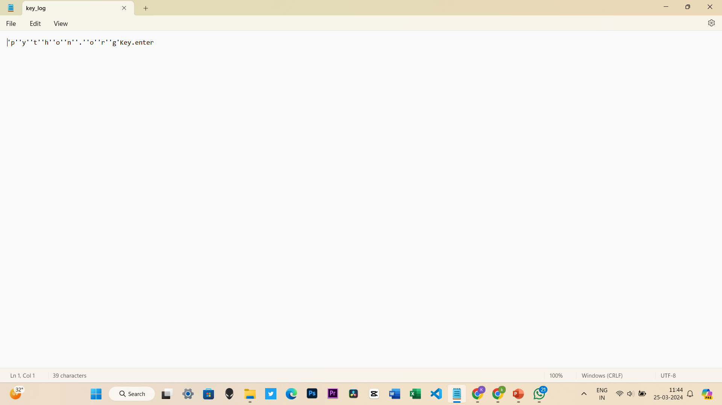
Result

Slide 8
Conclusion
In conclusion, the developed Python application successfully implements a basic keylogger with a graphical user interface (GUI) using the `pynput`, `tkinter`, and `json` libraries. The keylogger effectively captures keyboard events such as key presses, releases, and holds while running discreetly in the background without the user's awareness. The captured keystrokes are logged into both a text file (`key_log.txt`) and a JSON file (`key_log.json`) for later analysis.
The GUI provides functionalities to start and stop the keylogging process, enhancing user interaction and control over the application. The code incorporates error handling mechanisms to gracefully manage potential exceptions and errors, ensuring robustness and stability.
Furthermore, considerations for security, privacy, efficiency, and compatibility have been addressed, with a focus on handling logged data securely and optimizing resource usage to minimize detection.
Overall, this keylogger application serves as a demonstration of capturing keyboard inputs in a discreet manner, but it's essential to use such tools responsibly and ethically, with explicit consent and compliance with applicable laws and regulations. Additionally, users should be aware of the potential risks associated with keyloggers and take appropriate measures to mitigate them.

Slide 9
Future Scope
Enhancement Opportunities:
Remote Monitoring: Adding remote monitoring capabilities would enable administrators to access captured data from multiple devices remotely. This feature could include real-time alerts for suspicious activities, remote configuration management, and the ability to remotely wipe logs for security purposes.
Advanced Analytics: Incorporating advanced analytics tools could provide deeper insights into user behavior and patterns. Features such as behavior profiling, anomaly detection, and trend analysis could help identify potential security threats or productivity issues within an organization.
Integration with AI:
Predictive Alerts: Leveraging AI algorithms, the keylogger could predict potential security incidents or policy violations based on historical data and user behavior patterns. This could help organizations take proactive measures to prevent security breaches before they occur.
Natural Language Processing (NLP): Integrating NLP capabilities could enable the keylogger to analyze the content of typed text, such as emails, chat messages, or documents. This could help identify sensitive information, sentiment analysis, and language-based security threats.

Slide 10
References
Pynput Documentation: The official documentation for the Pynput library provides comprehensive information on how to use it for keyboard monitoring and mouse control in Python. You can find it on the Pynput GitHub repository or the official website.
Tkinter Documentation: For developers using Tkinter for creating a graphical user interface (if applicable), the official Tkinter documentation offers detailed guides and examples for building GUI applications in Python.
Python Official Documentation: The Python documentation itself is an invaluable resource for learning about Python syntax, standard libraries, and best practices. It covers everything from basic language features to advanced topics like concurrency and networking.
Security and Privacy Guidelines: It's essential to consult relevant guidelines and best practices for security and privacy when developing software that monitors user activities. Organizations like OWASP (Open Web Application Security Project) and the Electronic Frontier Foundation (EFF) offer resources and recommendations in this area.

Slide 11
THANK YOU

